Slide 1
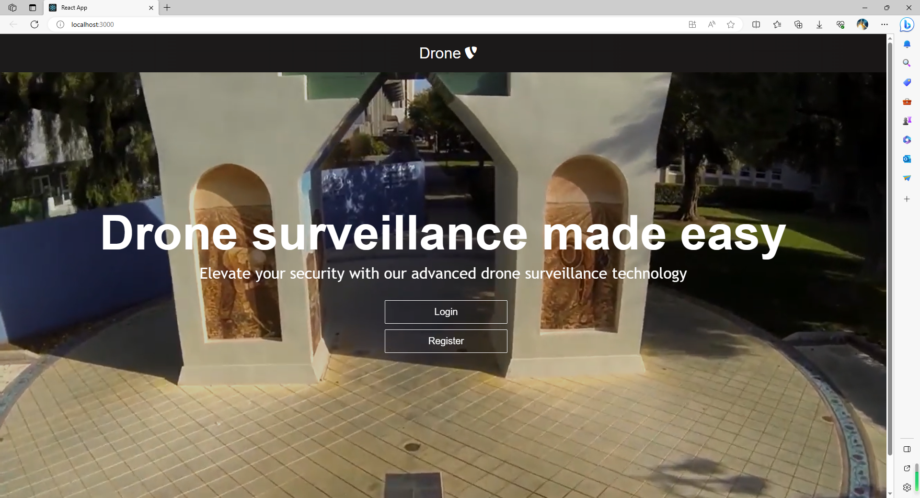
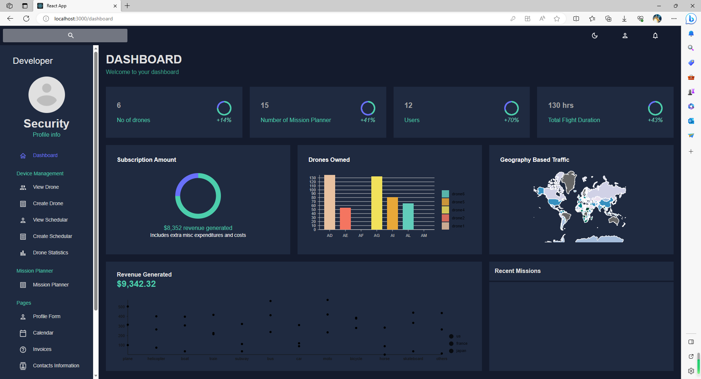
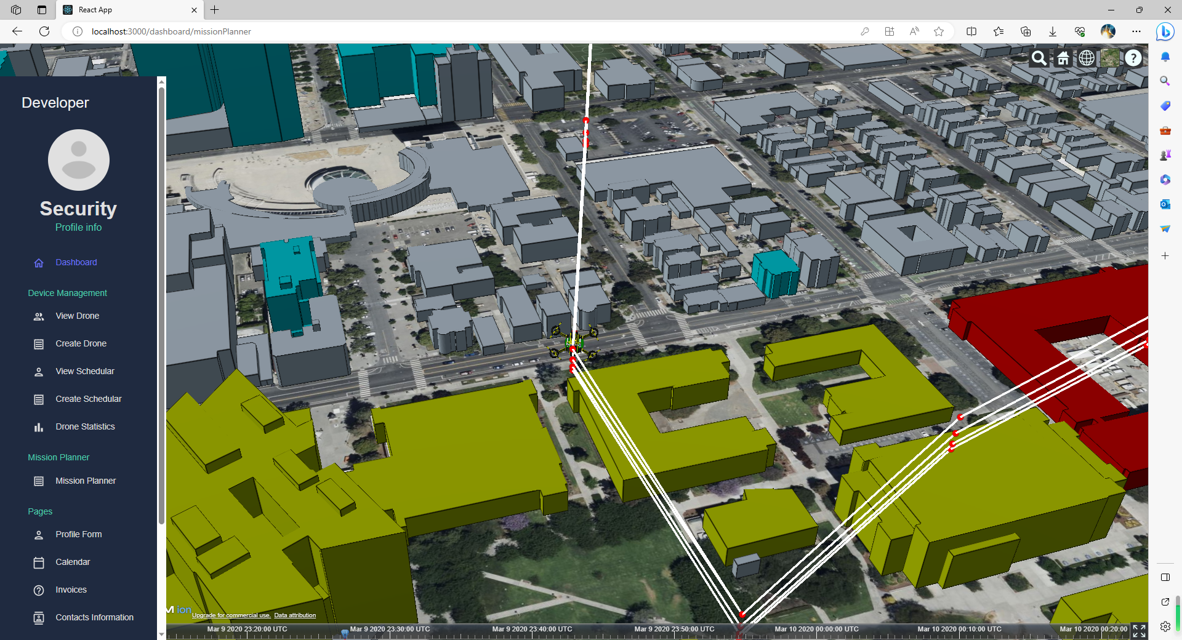
Service oriented drone mission planner
Prepared by David wang
Computer engineering
San jose state university

Slide 2
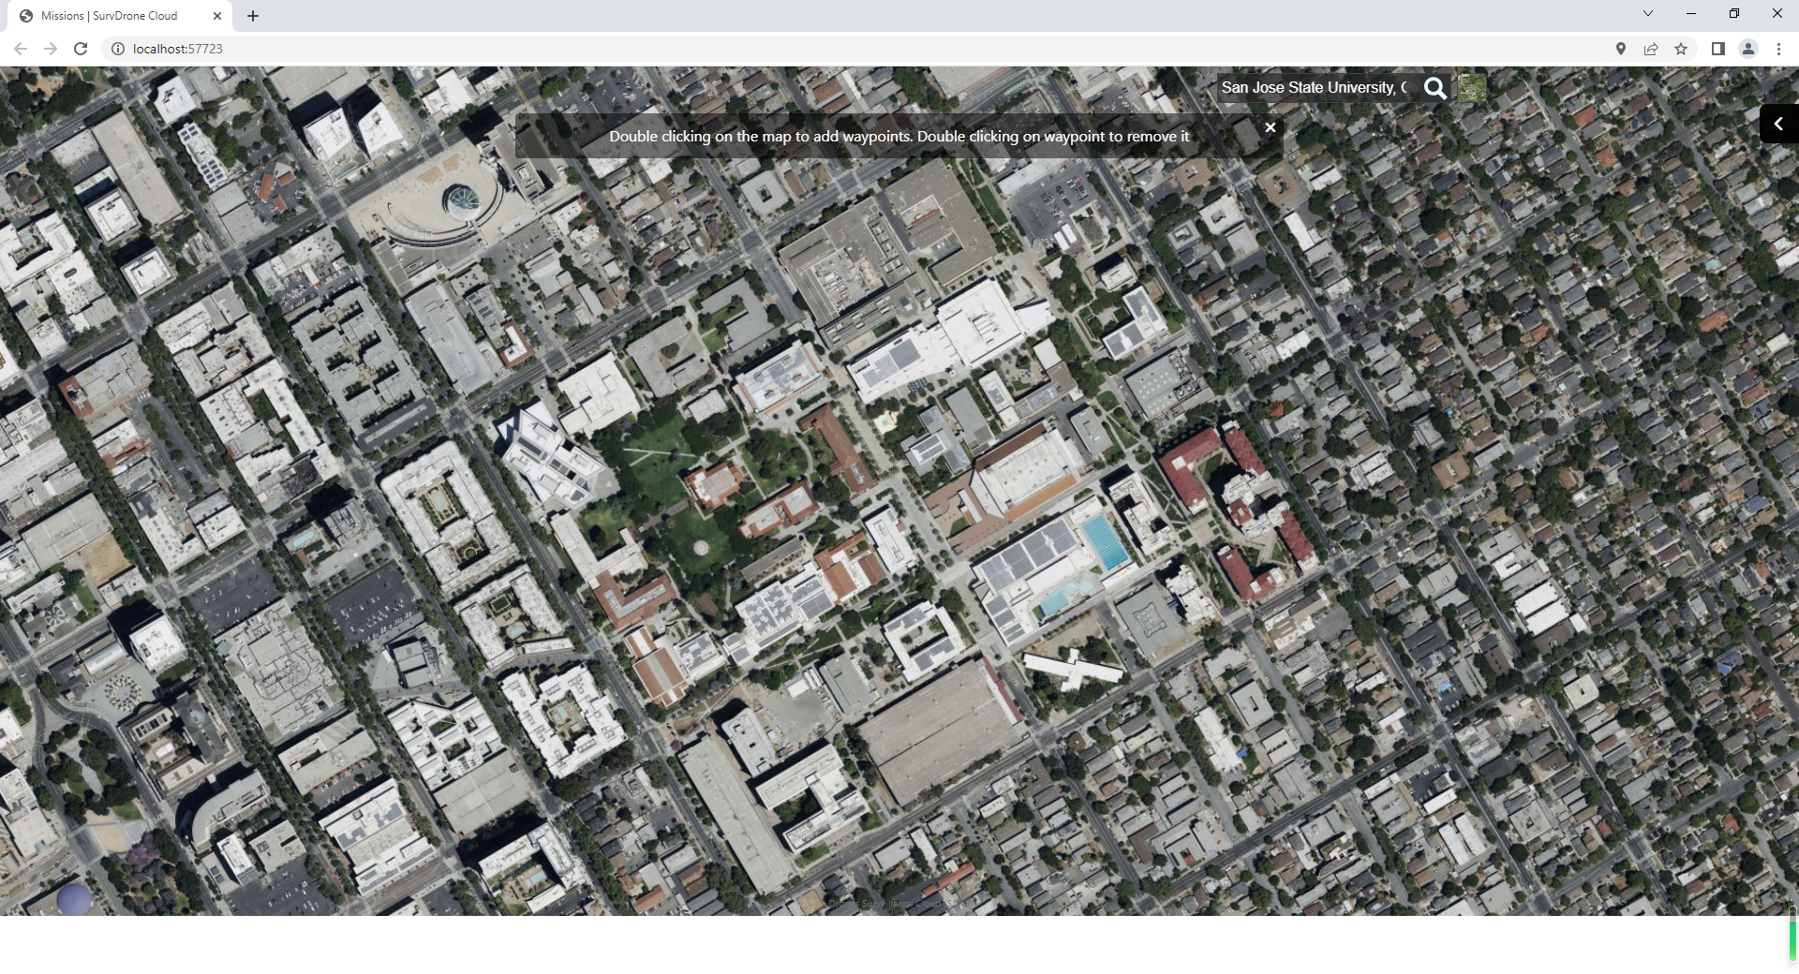
3-D Drone Service mission planer
When user click on “Create Misson” on side panel, enter the 3-D Cesium map view with mission editing functionalities
Integrated with Cesium 3-D map
Show alert message to prompt how to edit
Double click on Cesium map to add a waypoint
Double click on existing waypoint to remove it

Slide 3
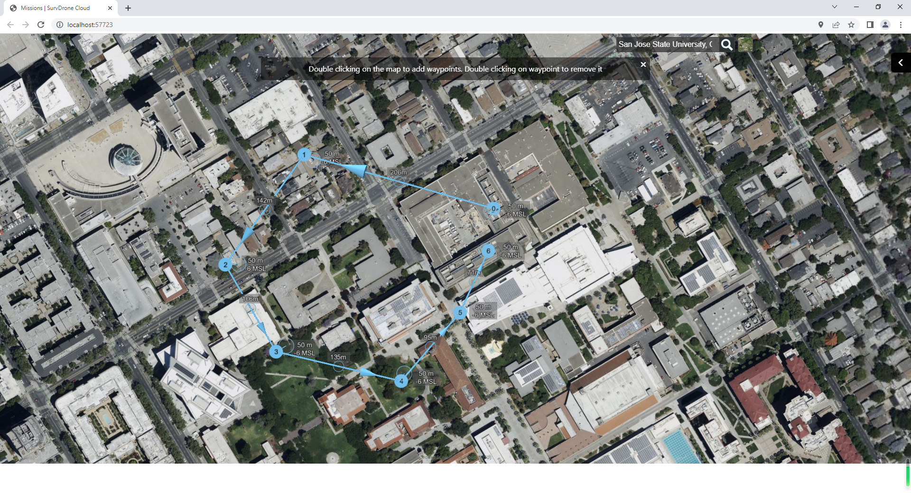
Add or remove waypoints
Double click on the Cesium map, waypoints will be created
Waypoint 0 is the docking station (home base)
Each waypoint will have two nodes. One on the ground is the ground node, one on the sky is the sky node
User can left click on the node and drag them around
The longitude, latitude and altitude will be updated after the dragging
Double click on a waypoint will remove it. The remaining waypoint index will be reassigned. E.g. if delete waypoint 5, then the original waypoint 6 becomes waypoint 5

Slide 4
mission property panel
Mission property panel will be shown on the right
Mission header
Mission ID
Mission name (editable)
Address of the mission (according to waypoint 0)
Drone selection
Waypoints list (scrollable list of the properties of each waypoint)
Longitude, latitude, altitude, heading, speed, action, whatever has been modeled in backend
There will be a delete button on each waypoint property
Mission summary
Show total number of waypoints
Show total flying time
Show total distance
The summary will be updated when waypoints are added, edited or deleted
Save and cancel button to save the mission data to the backend or discard the changes
The mission property panel can be hidden or expand by clicking an icon
Mission ID
Mission name:
Address
Drone selection
Waypoint 0 properties
Waypoint 1 properties
Waypoint 2 properties
Waypoint 3 properties
Waypoint 4 properties
Waypoint 5 properties
Waypoints:6, time: 4 minutes, distance: 50 m
Save
Cancel
Scroll bar

Slide 5
Load an existing mission and allow editing & save
When user click Load Mission from side panel, the mission content will be loaded to the Cesium map. The 3-D waypoints will be displayed on Cesium map. The mission properties will be shown in the Mission Properties panel as well
User can add, remove the waypoints, or change some property of some waypoints such as action
After user has done with the editing, the user can save the mission. The updated mission data should be sent to the backend
Mission ID
Mission name:
Address
Drone selection
Waypoint 0 properties
Waypoint 1 properties
Waypoint 2 properties
Waypoint 3 properties
Waypoint 4 properties
Waypoint 5 properties
Waypoints:6, time: 4 minutes, distance: 50 m
Save
Cancel
Scroll bar

Slide 6
Simulate flying in mission planner
There will be button “Sim” to on mission property panel or some other places to start the flying simulation of the mission
A drone 3-D image will fly through all waypoint and perform the action assigned to each waypoint
Mission ID
Mission name:
Address
Drone selection
sim
Waypoint 0 properties
Waypoint 1 properties
Waypoint 2 properties
Waypoint 3 properties
Waypoint 4 properties
Waypoint 5 properties
Waypoints:6, time: 4 minutes, distance: 50 m
Save
Cancel
Scroll bar

Slide 7
Next step
Demo the GUI functions in a standalone web application next week
Integrate with “Cloud Surveillance Drone” application (work with team members)
Integrate with backend data service (work with team members)

Slide 8
Week 8/25/2023 updates
Complete a prototype that can run as an independent webservice
Allow create waypoints on 3-D cesium map by double click on the map. The waypoint will have a ground node and air node
Allow drag the ground node to change the longitude and latitude
Allow drag the air node to change the altitude
Create a mission side panel to show details
Allow edit the name of the mission
Show mission address associated with waypoint 0 (takeoff)
Show way point details
Support longitude, latitude, altitude, delay and speed parameters (parameters that Michael has coved in his mission planner)
Update and show mission summary (Waypoint #, duration, distance)
Support Collapse all, show all, Hide mission from map, Show mission on map
When user drag waypoints on the map, the corresponding waypoint record will get updated

Slide 9
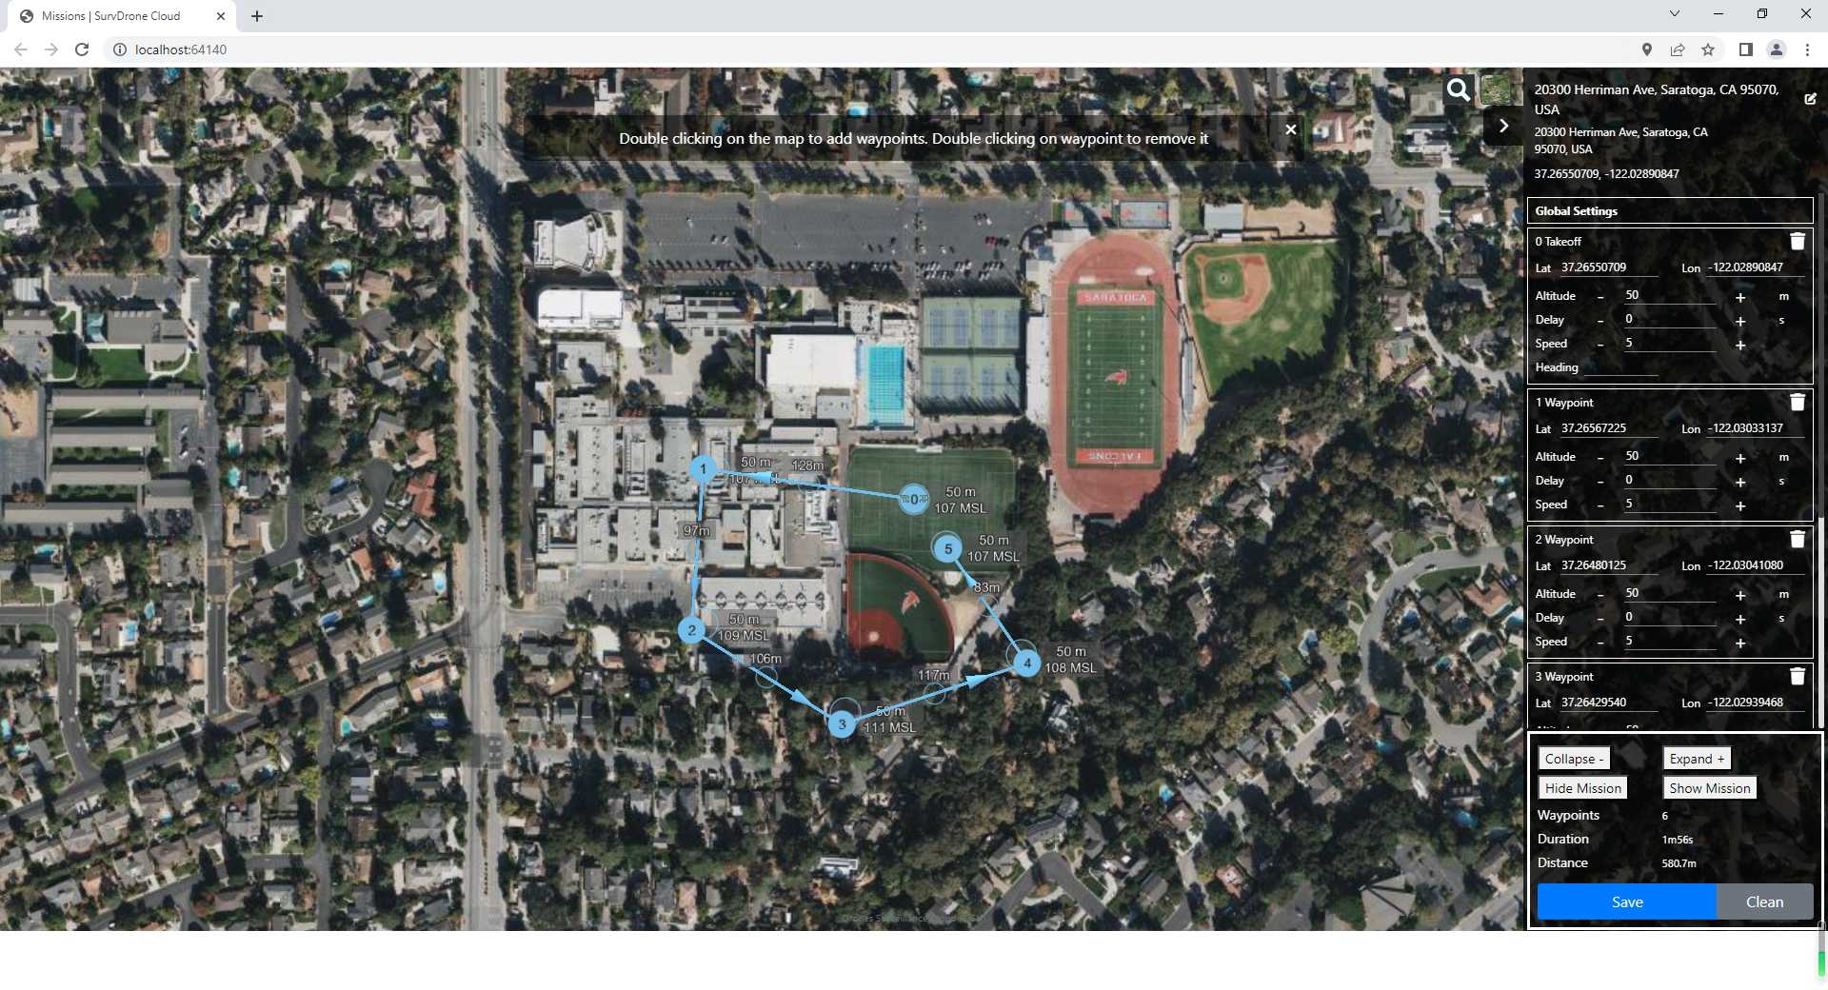
Create waypoints on cesium map and show details in side panel

Slide 10
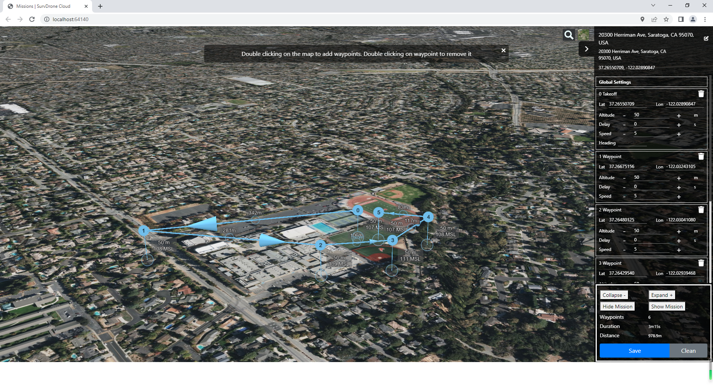
Drag ground node to change lon. And lat.
Update the number
In side panel
Drag on map

Slide 11
Drag air node to change altitude
Update the number
In side panel
Drag on map

Slide 12
Plan for next week
Save the mission content to a JSON file
Mission name
Mission address
Drone ID
Waypoint numbers
Waypoint 0 to Waypoint N records
Longitude
Latitude
Altitude
Delay
Speed
Load an existing mission

